Slide 1
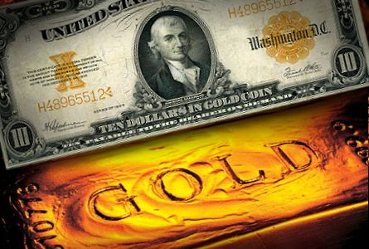
The Gold Standard
Victor Mieres
Harish Chandramohan
Minyeong Han
Tamari Bachulashvili
Lawrence Cummings

Slide 2
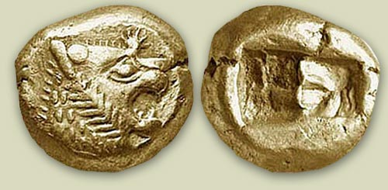
The G”olden” Days
The Lydians created first form of standardized currency by melting gold into coins in 700 B.C.
As time passed, more currencies were created by developed societies around the world, but they ran into a problem when global exchange become more prominent.
How could two countries engage in trade if they didn’t have a mutual benchmark for the value of goods nor knew the value of each other’s currency?

Slide 3

The Solution: Gold!

Slide 4
Objective
We wanted to know how many hours people who get paid minimum wage around the world should work to purchase 1 troy ounce of gold and use that data to determine the strength of each currency.
We drew insights based on the buying power of different currencies that we determined through our calculations and data presentation
Our project aims to illustrate and deduce the strength of each currency using gold as the standard to determine each of their value.

Slide 5
Data (exploration)
Csv file for the hourly minimum wage from:
https://stats.oecd.org/Index.aspx?DataSetCode=RMW#
CSV file for the Price of Gold using the Philadelphia Gold and Silver Index INDEXNASDAQ: XAU
https://www.investing.com/currencies/xau-usd-historical-data
Csv file for the countries latitudes and longitudes:
https://developers.google.com/public-data/docs/canonical/countries_csv

Slide 6
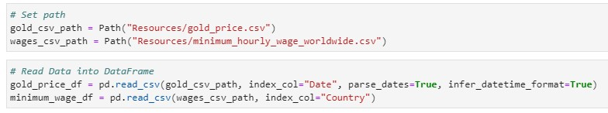
Data (cleanup process)
After checking the data sets:
From there we had to import the paths.
Defined our variable names for both data sets.

Slide 7
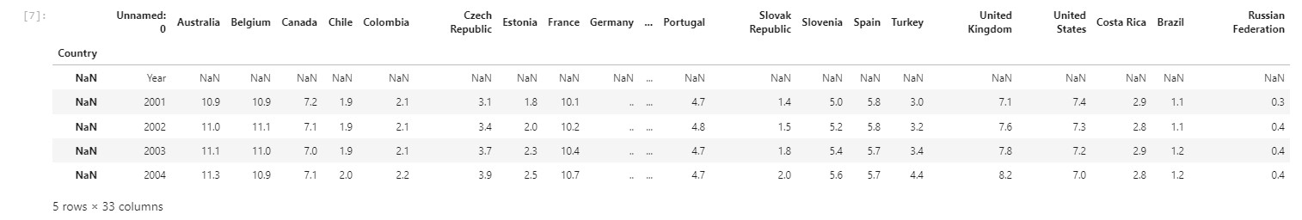
Data (cleanup process)
After checking the data sets:
We set the date as index
We proceed to drop unnecessary columns by using the .dropna() function, followed by adjusting the columns with numbers to floats using the str.replace() and .astype functions.

Slide 8
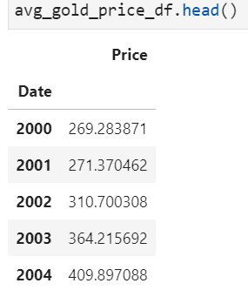
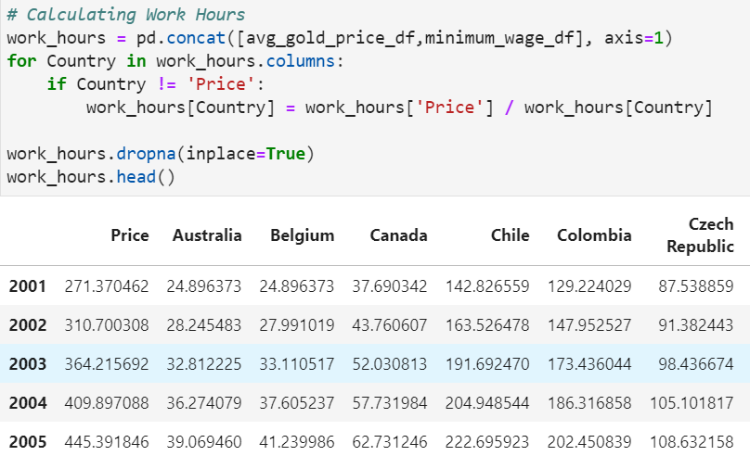
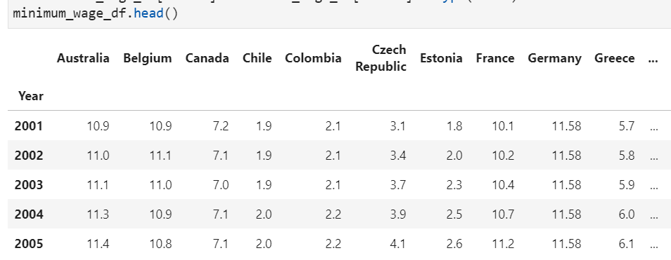
Analysis Process : Buying Power

Slide 9
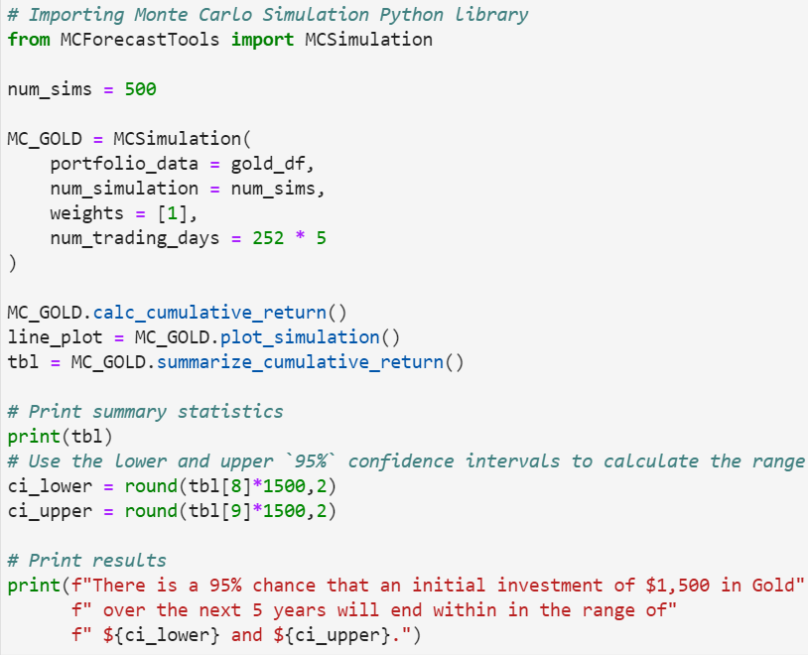
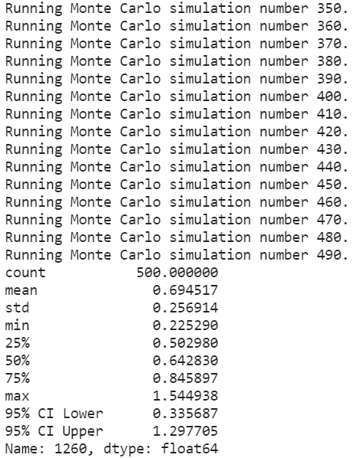
Analysis Process: Monte Carlo - Gold Price in 5 Years

Slide 10
Final Data Analysis: Panel Visualizations/Dashboard
First, we ran initial imports of modules and libraries, imported the CSVs to Pandas DataFrames and declared global variables.
Next, we defined panel visualization functions as follows:
Line plot of daily gold price in USD from 2000 to 2019
Line plot of minimum hourly wage by country
Line plot of the number of hours people earning minimum wage in each country need to work to purchase 1 troy oz of gold from 2001 to 2019
World Map that shows the number of hours needed to purchase 1 troy oz of gold in 2019.
Parallel plot of top 5 countries with highest minimum wage
Bar plot of minimum hourly wage from 2001 to 2019 for each country
We proceeded to create rows and columns for the panel tabs labeled: “Gold Price”, “Gold Buying Power”, “Minimum Wage” and “Highest Minimum Wage” and finally serve the panel dashboard.

Slide 11
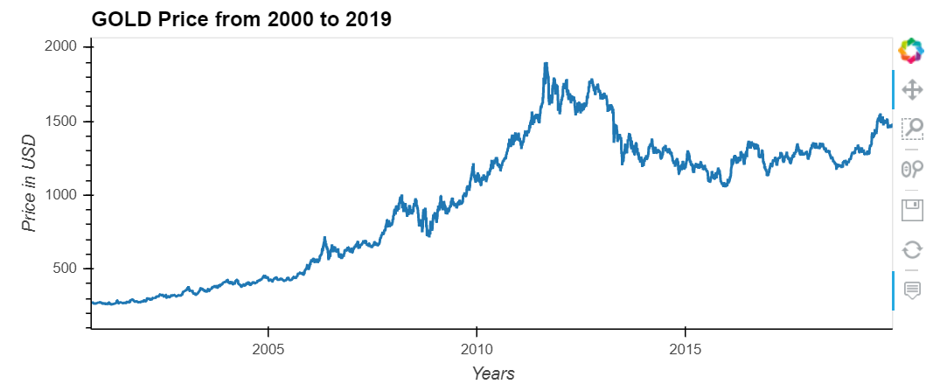
Conclusion
“Paranoid investors pushed gold to $1,900 an ounce in 2011, but the bubble has burst.” -slate.com

Slide 12
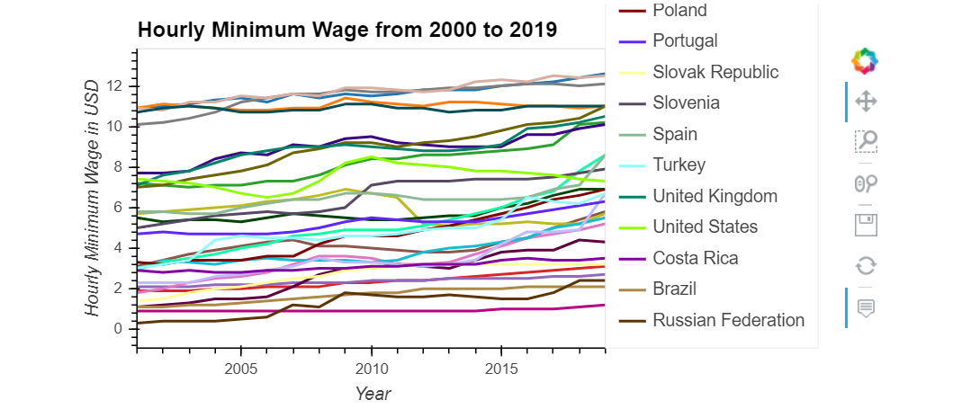
Over the last 20 years, most of countries increased their minimum hourly-wage.

Slide 13
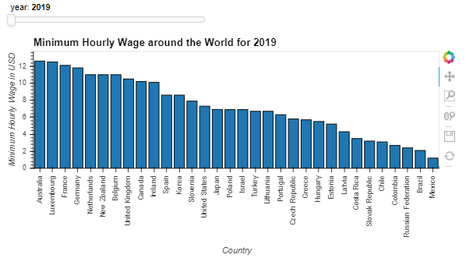
Over the last 20 years, Mexico's minimum hourly-wage hasn't changed. (0.9 USD in 2001 and 1.2 USD in 2019)

Slide 14
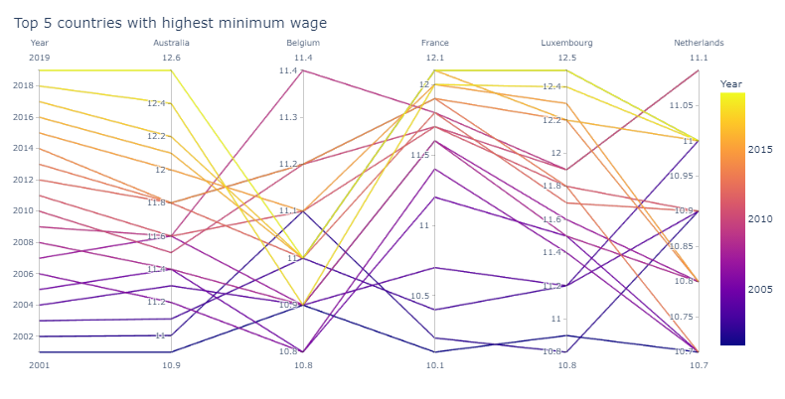
Although the standard of living in the US is high, it is not among the top 5 countries with the highest minimum hourly-wage in the world.

Slide 15
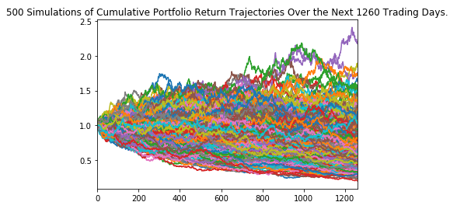
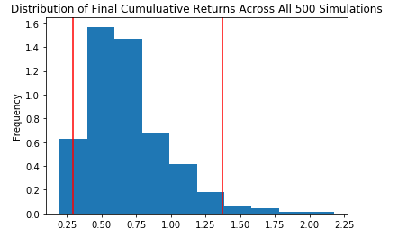
Our result showed that there was a 95% chance that an initial investment of $1,500( price of 1 troy oz) in Gold over the next 5 years will end within in the range of $442.4 and $2055.26 - volatility is pretty high

Slide 16
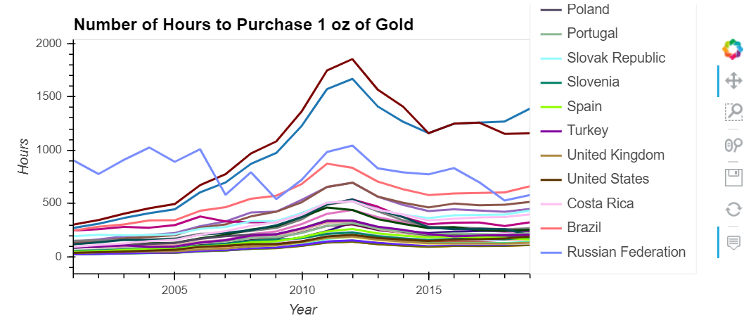
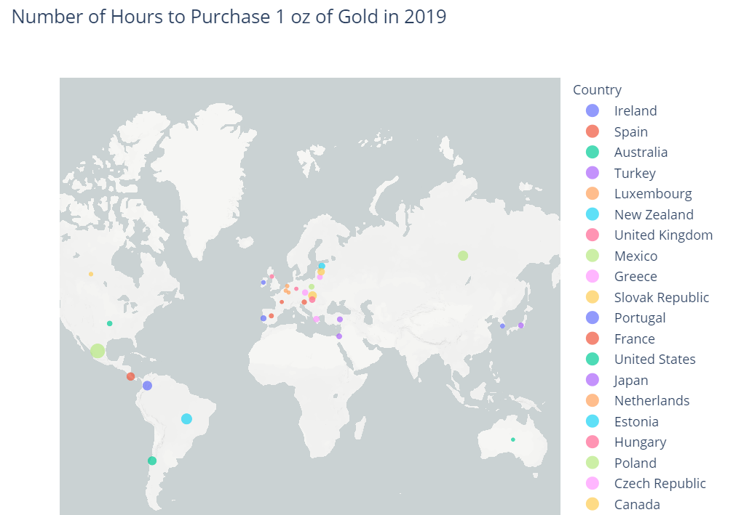
Mexico requires largest work hours (1160 hours =about 2.5 months of work) to purchase 1 oz of Gold in the world. (as of 2019)
Australia requires 110 hours (less than 3 weeks) of work to purchase 1 oz of Gold.
US requires 190 hours (less than 5 weeks) of work to purchase 1 oz of Gold.

Slide 17
Implications & discussion
Purchasing Power Parity (PPP) allows us to compare economies more effectively than nominal purchasing power. It enables us to assume that all people are using the same currency and that prices all over the world are the same, helping us measure the affluence of each country in a comparable way.
Our project used the gold price and U.S. dollar as currency to analyze the work hours to purchase the same amount of gold around the world, and this provides a clearer picture of the global economy. (the inverse of work hours = Purchasing Power)
Weak currency is related to more work hours to buy 1 oz of gold. (e.g. current (Nov. 14, 2020) 1 Mexico Peso = 0.049 USD ~ 20 times more work hours of US)
South America tends to require large work hours, and Europe requires smaller work hours to purchase 1 oz of Gold.
Investors can use PPP figures to find potentially overvalued or undervalued currencies, or to predict whether the U.S. dollar – and so the price of gold – will appreciate or depreciate.
Gold behaves like a currency, in a sense, so it is sensitive to changes in exchange rates between national fiat currencies and the divergence in monetary policies of the major central banks.

